Slide 1

ANOVA
Two Groups or Too Many?
Try Analysis of Variance (ANOVA)
H₀: μ₁ = μ₂ = μ₃ = μ₄ vs. H₁: μ_{i} ≠ μ_{j}

Slide 2
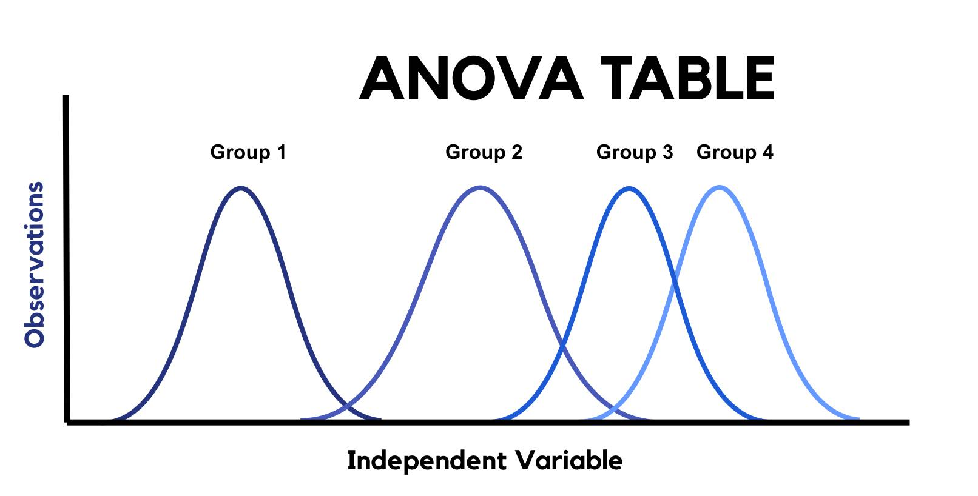
The question is:
Are these groups different? That’s it. That’s the test.

Slide 3
When would you run an ANOVA?
Type of Response Data
Continuous Counts (Frequency) Categorical
Research Question
Difference Relationships Predictions
# Samples to Compare
One Two >Two
Are Samples Independent?
Are Samples Independent?
Yes No
Yes No
# treatment variables
One
Parametric
Non-Parametric
One sample z-test
Ind. t-test
Depend t-test (match pairs)
Analysis of Variance F-test
Tukey’s HSD Means Comparison
Dunnet’s with Control
Wilcoxon signed rank
z-test
Wilcoxon signed rank Ind. t-test
Wilcoxon signed rank Dep t-test
Kruskal Wallis ANOVA
Steel-Dwass all Pairs
Steel with control

Slide 4
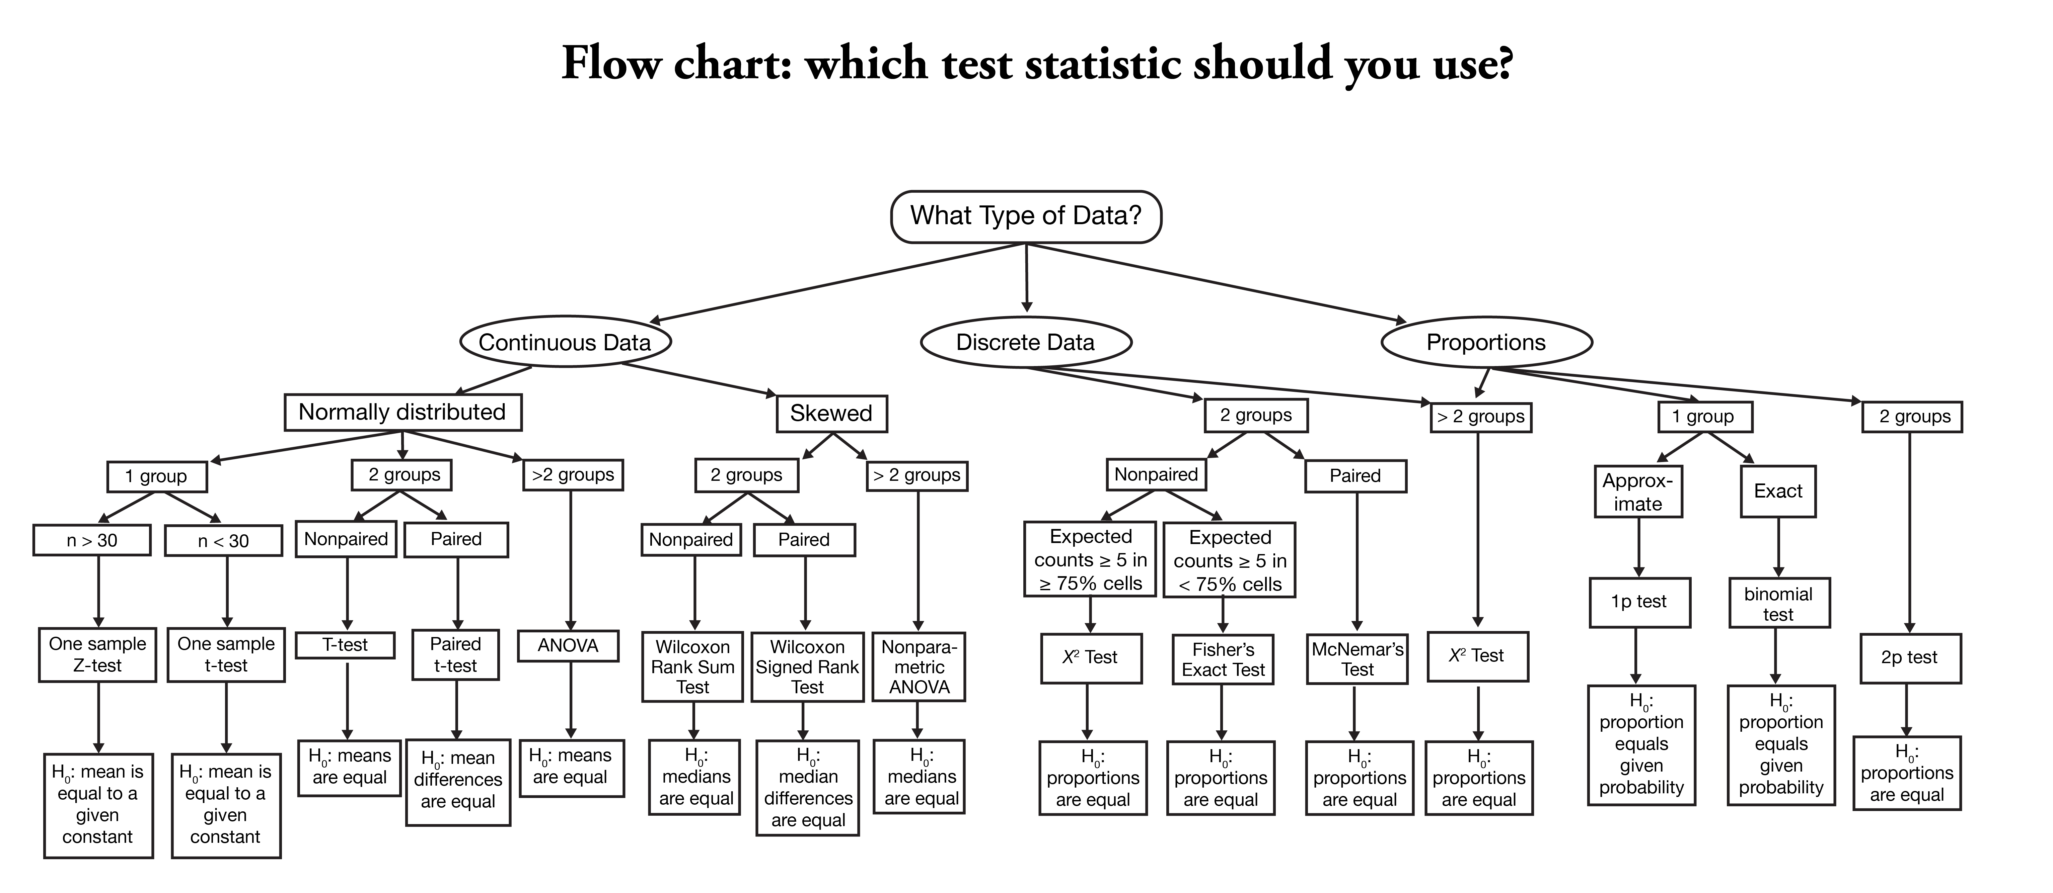

Slide 5
When would you run an ANOVA?
So, when do I use an ANOVA?
I have a continuous response variable
I want to know the difference in that response between more than two groups
I have one factor I am testing (One-Way ANOVA)
Assumptions:
All groups are Independent
The data is normally distributed
All groups have approximately equal variance
A good rule of thumb: ratio of largest to smallest group stdev must be less than 2:1
The ANOVA is less sensitive to this requirement when samples are of equal size from each population

Slide 6
How ANOVA works (A New Table Flavor)
The ANOVA obtained value (the F-statistic) is a ratio of the Between Group Variation divided by the Within Group Variation:
Each of these has its own formula
A large F is evidence against H₀, since it indicates that there is more difference between groups than within groups.

Slide 7
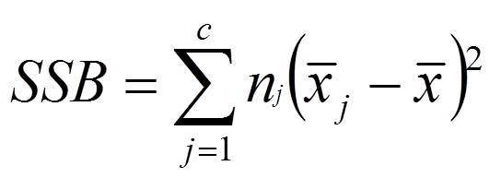
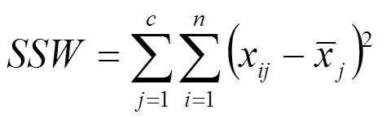
One-way ANOVA Summary Table
Source of Variation | Degrees of Freedom | Sum of Squares | Mean Squares (Variance) | F Statistic
Between (Factor) | c – 1 | SSB | MSB = SSB/(c – 1 ) | MSB/MSW
Within (Error) | n – c | SSW | MSW = SSW/(n – c )
Total | n – 1 | SST = SSB + SSW

Slide 8
One-way ANOVA Formulas
Source of Variation | Degrees of Freedom | Sum of Squares | Mean Squares (Variance) | F Statistic
Between (Factor) | c – 1 | SSB | MSB = SSB/(c – 1 ) | MSB/MSW
Within (Error) | n – c | SSW | MSW = SSW/(n – c )
Total | n – 1 | SST = SSB + SSW

Slide 9
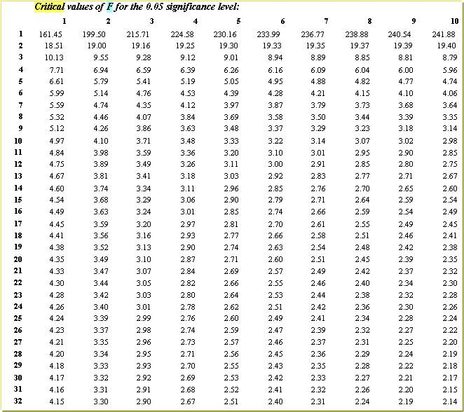
How ANOVA works
Finding the critical value for an F-test
You will need the critical F table that matches your significance level
And you will need to know the degrees of freedom for both the between and within variability
Use df_{B} (between) to find the right column, and
df_{W} (within) to find the right row in the table.
This is your critical value

Slide 10
Where is the difference?
All that the ANOVA test tells you is if there is a significant difference somewhere among your groups.
You must conduct Post-Hoc Means Comparison tests to find out which groups are different from which other groups

Slide 11
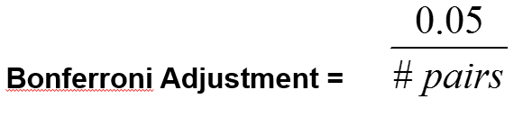
Where is the difference?
Type I error: False positive, occurs when a true null hypothesis is incorrectly rejected.
For example: incorrectly conclude that a drug works, when it doesn’t.
Be careful: Type I error increases with every possible comparison made at a rate of:
1 – (1 – alpha)^{k} Where k = number of possible comparisons and alpha is your p-value threshold
You can use a Bonferroni Adjustment to allow you to use a simple t-test to compare all means

Slide 12
Practice – Compounding Error
If I want to see which grade level (freshman, sophomore, junior, senior, grad) differ from each other after my ANOVA shows that there is some difference......and I decide to do a bunch of t-tests to compare each pair individually to find which ones are different from each other......and I use a significance cut off of 0.05: What is my actual significance level (after being compounded by all of these different comparisons)

Slide 13
Practice – Compounding Error
What is my actual significance level (chance of a Type 1 error) after being compounded by all of these different comparisons
F So J Sr Gr
= 10 comparisons
Or use k = c*(c-1)/2 = (5*4)/2 = 10
Notes:
OK....use the formula from the previous question 1 - (1 - α)^{k} and our is 0.05 and our k (# of possible comparisons) = 10 So = 0.40

Slide 14
Practice – Compounding Error
What is the Bonferroni Adjustment to keep my overall alpha level for multiple comparisons of five groups (10 comparisons) at 0.05?
Reducing the significance level from 0.05 to 0.005 makes the criteria for rejecting the null hypothesis more rigorous. In other words, it decreases the likelihood of making a Type I error.
α
k
0.05
10
=
= 0.005
Notes:
bonferoni adjustment takes the desired p-value threshold (here assume 0.05) divided by the total number of comparisons = 0.05/3 =0.0167

Slide 15
Effect size measures
Significant F ratios show that there is a difference between the treatment groups that cannot be explained by chance alone.
Effect size measures show how big / meaningful the effect of the treatment is.
one simple effect size measure:
r² = SSB / SST
How much of the total variability in our data set can be explained by the different groupings
What is meaningful? It depends on how much of the total variability you would expect this grouping to be able to account for

Slide 16
Effect size measures
Significant F ratios show that there is a difference between the treatment groups that cannot be explained by chance alone.
Effect size measures show how big / meaningful the effect of the treatment is.
What is meaningful?
It depends on how much of the total variability you would expect this grouping to be able to account for

Slide 17
How to summarize results
State the original research question / hypothesis
Briefly describe the methods including the type of test run: One-way ANOVA, if significant type of Means Comparison (e.g. Tukey’s HSD Means Comparison)
Describe your results including:
Shorthand: F _{(3,12)} = 16.62, p < 0.023, r² = 0.82)
Results of any means comparison (which groups are larger than which other groups? Which are the same?
Interpret significance and effect size (r²), big picture: what does this mean in terms of your original research question?

Slide 18
Practice – ANOVA Tables
Consider that you have data where the SSB = 2150 and the SSW = 5269. The total sample size is 40, and there are six groups examined.
Let's build an ANOVA table and summarize the result of this ANOVA.

Slide 19
One-way ANOVA Summary Table
Source of Variation | Degrees of Freedom | Sum of Squares | Mean Squares (Variance) | F Statistic
Between (Factor) | c – 1 | SSB | MSB = SSB/(c – 1 ) | MSB/MSW
Within (Error) | n – c | SSW | MSW = SSW/(n – c )
Total | n – 1 | SST = SSB + SSW

Slide 20
Quiz Practice – ANOVA Tables
Sample Size 40, 6 groups
Source of Variation | Degrees of Freedom | Sum of Squares | Mean Squares (Variance) | F Statistic
Between (Factor) |  | 2150
Within (Error) |  | 5269
Total
P-value = ?
R2 = ?
Bonferroni Adjusted alpha?

Slide 21
Quiz Practice – ANOVA Tables
Sample Size 40, 6 groups
Source of Variation | Degrees of Freedom | Sum of Squares | Mean Squares (Variance) | F Statistic
Between (Factor) | c – 1 | 2150
Within (Error) |  | 5269
Total
P-value = ?
R2 = ?
Bonferroni Adjusted alpha?

Slide 22
Quiz Practice – ANOVA Tables
Sample Size 40, 6 groups
Source of Variation | Degrees of Freedom | Sum of Squares | Mean Squares (Variance) | F Statistic
Between (Factor) | 5 | 2150
Within (Error) |  | 5269
Total
P-value = ?
R2 = ?
Bonferroni Adjusted alpha?

Slide 23
Quiz Practice – ANOVA Tables
Sample Size 40, 6 groups
Source of Variation | Degrees of Freedom | Sum of Squares | Mean Squares (Variance) | F Statistic
Between (Factor) | 5 | 2150
Within (Error) | n – c | 5269
Total
P-value = ?
R2 = ?
Bonferroni Adjusted alpha?

Slide 24
Quiz Practice – ANOVA Tables
Sample Size 40, 6 groups
Source of Variation | Degrees of Freedom | Sum of Squares | Mean Squares (Variance) | F Statistic
Between (Factor) | 5 | 2150
Within (Error) | 34 | 5269
Total
P-value = ?
R2 = ?
Bonferroni Adjusted alpha?

Slide 25
Quiz Practice – ANOVA Tables
Sample Size 40, 6 groups
Source of Variation | Degrees of Freedom | Sum of Squares | Mean Squares (Variance) | F Statistic
Between (Factor) | 5 | 2150
Within (Error) | 34 | 5269
Total | n – 1
P-value = ?
R2 = ?
Bonferroni Adjusted alpha?

Slide 26
Quiz Practice – ANOVA Tables
Sample Size 40, 6 groups
Source of Variation | Degrees of Freedom | Sum of Squares | Mean Squares (Variance) | F Statistic
Between (Factor) | 5 | 2150
Within (Error) | 34 | 5269
Total | 39
P-value = ?
R2 = ?
Bonferroni Adjusted alpha?

Slide 27
Quiz Practice – ANOVA Tables
Sample Size 40, 6 groups
Source of Variation | Degrees of Freedom | Sum of Squares | Mean Squares (Variance) | F Statistic
Between (Factor) | 5 | 2150
Within (Error) | 34 | 5269
Total | 39 | SST = SSB + SSW
P-value = ?
R2 = ?
Bonferroni Adjusted alpha?

Slide 28
Quiz Practice – ANOVA Tables
Sample Size 40, 6 groups
Source of Variation | Degrees of Freedom | Sum of Squares | Mean Squares (Variance) | F Statistic
Between (Factor) | 5 | 2150
Within (Error) | 34 | 5269
Total | 39 | 7419
P-value = ?
R2 = ?
Bonferroni Adjusted alpha?

Slide 29
Quiz Practice – ANOVA Tables
Sample Size 40, 6 groups
Source of Variation | Degrees of Freedom | Sum of Squares | Mean Squares (Variance) | F Statistic
Between (Factor) | 5 | 2150 | MSB = SSB/(c – 1 )
Within (Error) | 34 | 5269
Total | 39 | 7419
P-value = ?
R2 = ?
Bonferroni Adjusted alpha?

Slide 30
Quiz Practice – ANOVA Tables
Sample Size 40, 6 groups
Source of Variation | Degrees of Freedom | Sum of Squares | Mean Squares (Variance) | F Statistic
Between (Factor) | 5 | 2150 | MSB = 2150/5
Within (Error) | 34 | 5269
Total | 39 | 7419
P-value = ?
R2 = ?
Bonferroni Adjusted alpha?

Slide 31
Quiz Practice – ANOVA Tables
Sample Size 40, 6 groups
Source of Variation | Degrees of Freedom | Sum of Squares | Mean Squares (Variance) | F Statistic
Between (Factor) | 5 | 2150 | 430
Within (Error) | 34 | 5269
Total | 39 | 7419
P-value = ?
R2 = ?
Bonferroni Adjusted alpha?

Slide 32
Quiz Practice – ANOVA Tables
Sample Size 40, 6 groups
Source of Variation | Degrees of Freedom | Sum of Squares | Mean Squares (Variance) | F Statistic
Between (Factor) | 5 | 2150 | 430
Within (Error) | 34 | 5269 | MSW = SSW/(n – c)
Total | 39 | 7419
P-value = ?
R2 = ?
Bonferroni Adjusted alpha?

Slide 33
Quiz Practice – ANOVA Tables
Sample Size 40, 6 groups
Source of Variation | Degrees of Freedom | Sum of Squares | Mean Squares (Variance) | F Statistic
Between (Factor) | 5 | 2150 | 430
Within (Error) | 34 | 5269 | MSW = 5269/(34)
Total | 39 | 7419
P-value = ?
R2 = ?
Bonferroni Adjusted alpha?

Slide 34
Quiz Practice – ANOVA Tables
Sample Size 40, 6 groups
Source of Variation | Degrees of Freedom | Sum of Squares | Mean Squares (Variance) | F Statistic
Between (Factor) | 5 | 2150 | 430
Within (Error) | 34 | 5269 | 155
Total | 39 | 7419
P-value = ?
R2 = ?
Bonferroni Adjusted alpha?

Slide 35
Quiz Practice – ANOVA Tables
Sample Size 40, 6 groups
Source of Variation | Degrees of Freedom | Sum of Squares | Mean Squares (Variance) | F Statistic
Between (Factor) | 5 | 2150 | 430 | MSB/MSW
Within (Error) | 34 | 5269 | 155
Total | 39 | 7419
P-value = ?
R2 = ?
Bonferroni Adjusted alpha?

Slide 36
Quiz Practice – ANOVA Tables
Sample Size 40, 6 groups
Source of Variation | Degrees of Freedom | Sum of Squares | Mean Squares (Variance) | F Statistic
Between (Factor) | 5 | 2150 | 430 | 2.77
Within (Error) | 34 | 5269 | 155
Total | 39 | 7419
P-value = ?
R2 = ?
Bonferroni Adjusted alpha?

Slide 37
Quiz Practice – ANOVA Tables
Sample Size 40, 6 groups
Source of Variation | Degrees of Freedom | Sum of Squares | Mean Squares (Variance) | F Statistic
Between (Factor) | 5 | 2150 | 430 | 2.77
Within (Error) | 34 | 5269 | 155
Total | 39 | 7419
P-value =F.DIST(2.77,5,34,)
R2 = ?
Bonferroni Adjusted alpha?

Slide 38
Quiz Practice – ANOVA Tables
Sample Size 40, 6 groups
Source of Variation | Degrees of Freedom | Sum of Squares | Mean Squares (Variance) | F Statistic
Between (Factor) | 5 | 2150 | 430 | 2.77
Within (Error) | 34 | 5269 | 155
Total | 39 | 7419
P-value = 0.048
R2 = ?
Bonferroni Adjusted alpha?

Slide 39
Quiz Practice – ANOVA Tables
Sample Size 40, 6 groups
Source of Variation | Degrees of Freedom | Sum of Squares | Mean Squares (Variance) | F Statistic
Between (Factor) | 5 | 2150 | 430 | 2.77
Within (Error) | 34 | 5269 | 155
Total | 39 | 7419
P-value = 0.048
R2 = SSB / SST
Bonferroni Adjusted alpha?

Slide 40
Quiz Practice – ANOVA Tables
Sample Size 40, 6 groups
Source of Variation | Degrees of Freedom | Sum of Squares | Mean Squares (Variance) | F Statistic
Between (Factor) | 5 | 2150 | 430 | 2.77
Within (Error) | 34 | 5269 | 155
Total | 39 | 7419
P-value = 0.048
R2 = 2150 / 7419
Bonferroni Adjusted alpha?

Slide 41
Quiz Practice – ANOVA Tables
Sample Size 40, 6 groups
Source of Variation | Degrees of Freedom | Sum of Squares | Mean Squares (Variance) | F Statistic
Between (Factor) | 5 | 2150 | 430 | 2.77
Within (Error) | 34 | 5269 | 155
Total | 39 | 7419
P-value = 0.048
R2 = 0.29
Bonferroni Adjusted alpha?
.05
.05
α
____
____
____
=
=
=
6*(6-1)/2
15
c*(c-1)/2

Slide 42
Quiz Practice – ANOVA Tables
Sample Size 40, 6 groups
Source of Variation | Degrees of Freedom | Sum of Squares | Mean Squares (Variance) | F Statistic
Between (Factor) | 5 | 2150 | 430 | 2.77
Within (Error) | 34 | 5269 | 155
Total | 39 | 7419
P-value = 0.048
R2 = 0.29
Bonferroni Adjusted alpha?
α
k
.05
.05
α
____
____
____
=
=
.003
=
=
6*(6-1)/2
15
c*(c-1)/2

Slide 43
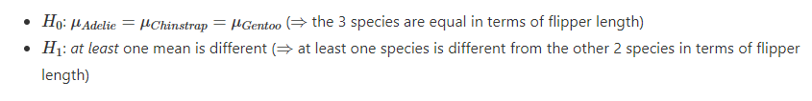
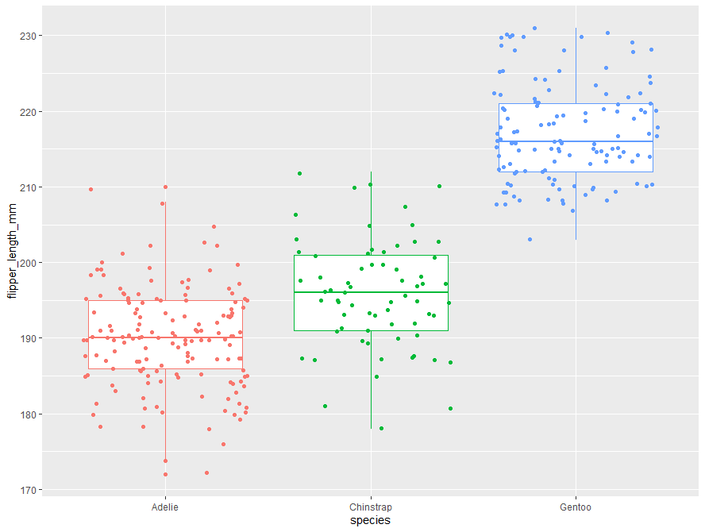
Let's practice in R

Slide 44
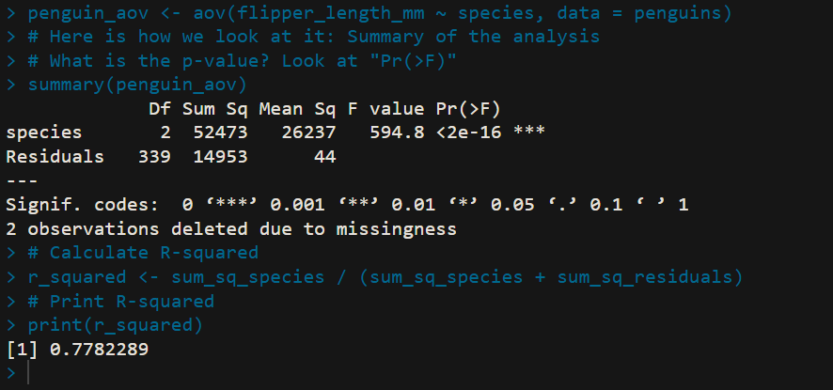
Let's practice in R
Given that the p-value is smaller than 0.05, we reject the null hypothesis, so we reject the hypothesis that all means are equal.
Therefore, we can conclude that at least one species is different than the others in terms of flippers length (p-value < 2.2e-16).

